Slide 1

Star Wars Movies
Data Preparation, Data Exploration & Result Analysis
Notes:
Greetings everyone,
My name is Shonil Dabreo.
This presentation is about the Data preparation, Data exploration and Result Analysis of starwars movies.
Before moving further, I’d like to explain you all about the Starwars dataset.
This dataset contains data behind the story America’s favorite ‘Star Wars’ movies. The author collected the data by running a poll through SurveyMonkey Audience, surveying 1,186 respondents.
The questions asked in the survey were,
Have you seen any of the 6 ﬁlms in the Star Wars franchise?
Do you consider yourself to be a fan of the Star Wars ﬁlms franchise?
Please select the movies that you have seen and give the rating for the movies with 1 being your favourite film and 6 being your least favourite film
Which character shot ﬁrst?
Are you familiar with the Expanded Universe?
Do you consider yourself to be a fan of the Expanded Universe?
Do you consider yourself to be a fan of the Star Trek franchise?
And about the people’s demographics such as Gender, Age, Education, Household Income & Location.
The data collected need to be carefully prepared so that we get better results for analysis.
Moving on to the Data Preparation phase.

Slide 2
Data Preparation

Slide 3
Data Preparation
Retrieving data
Checking data types
Checking for typos
Checking for Extra Whitespaces
Changing cases
Sanity checks
Handling missing values
Notes:
A Data preparation involves a series of steps before we start working for analysis.
These are the steps for Data preparation:

Slide 4
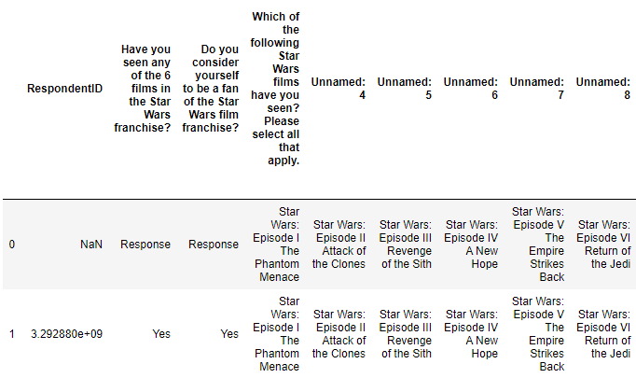
Retrieving data
Dataset imported using read_csv function
Notes:
The dataset is imported using pandas read_csv function.
We can see the contents of the dataset which represents data in a table format.
The dataset contains some unnamed column names and the first row includes the list of options from the survey.

Slide 5
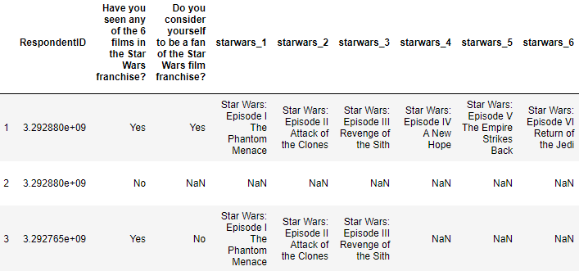
Retrieving data
Unnamed columns are renamed using rename() function
First row is removed from the dataset
Notes:
Using pandas rename function, the unnamed columns are renamed and the first row is removed from the dataset.
We can see the changes done to the dataset after renaming the unnamed columns and removing the first row of the dataset.

Slide 6
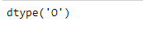
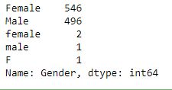
Checking data types
Datatype of Gender
Unique values of Gender with their total count
Setting ‘category’ datatype to Gender using astype() function
Notes:
When the dataset is loaded, all the data is in object format. Thus, depending on the data values, we need to change the datatype appropriately.
As we can see,
In the first fig, the letter O represents the Object datatype for gender.
The second fig represents that Gender has 5 unique values with their total count.
We all know, A gender of a person can be either Male or Female.
So, setting the ‘category’ datatype to gender by using pandas’ astype() function.
The third fig is the result for the Gender with category data type.

Slide 7
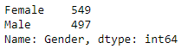
Checking for typos
Checking typos for Gender
Correcting the typos using loc[] function
Notes:
Now, looking at the first fig, we can see that there have been some typo mistakes.
The values with typo mistakes are corrected by using pandas loc[] function. This is done by selecting the typo values and assigning them with a corrected value.
Fig two shows the output of the Gender values after correcting the typo mistakes. All the other values were replaced with either Male or Female.

Slide 8
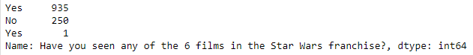
Checking for Extra Whitespaces
Extra Whitespace in ‘Yes’ value
Whitespaces removed from ‘Yes’ value
Notes:
In the first fig, We can see that there are two values for ‘Yes’. This means that the user might have entered an extra whitespace while answering the question.
Pandas’ str.strip() function is used to remove the whitespaces.
In the fig two, we can see that the ‘Yes’ values are combined and the white spaces are removed.

Slide 9
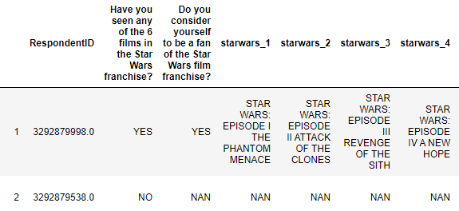
Changing cases
Casting textual data into Upper case using str.upper() function
Notes:
We can also change the case for the contents of the dataset.
In the given fig, we can see that the contents are displayed in Upper case.
Pandas’ str.upper() function is used to cast all data into upper case.

Slide 10
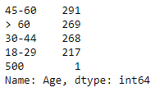
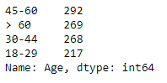
Sanity checks
Sanity check for Age
Replacing 500 value with 45-60 value
Notes:
In the first fig, we can see the values for each age group. However, there is one value where the age is 500.
We know that a person can have age not more than 110.
As the 45-60 age group has the highest count, adding more value to it would still have the same result.
Considering this, the age with 500 value is replaced with the 45-60 value.
In the second figure, we can see the 500 value replaced with 45-60 value.

Slide 11
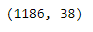
Handling missing values
Dropping rows with missing values
Notes:
Handling missing values is an essential and time consuming step of the data preparation.
In the first fig, we can see that there are 1186 rows and 38 columns
Whereas, in the second fig we can see that there are 1076 rows. The rows having null values for demographic data such as Gender, Age, etc were removed using pandas’ drop function.

Slide 12
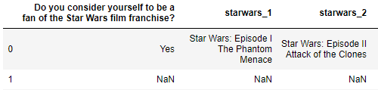
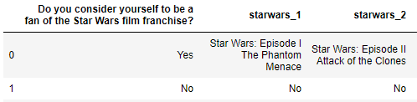
Handling missing values: Fixed value
Replacing missing values with ‘No’ using replace() function
Notes:
In the first fig, we can see that there are NaN i.e. null values in those columns.
These columns could either have ‘Yes’ or ‘No’ values.
Based on a condition, the missing values for these columns are replaced with ‘No’ values using pandas’ replace function.

Slide 13
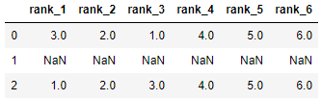
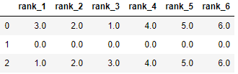
Handling missing values: Fixed value
Filling missing values with 0 using ffill method of fillna() function
Notes:
Looking at these figures, we can see that these columns have the numerical values.
These are the user ratings given to 6 films in order of preference with 1 being the favorite film and 6 being the least favorite film.
Assuming, people didn’t watch any of the movies so they didn’t enter the ratings for those movies.
Therefore, these missing values are filled with ‘0’ values using pandas’ fillna function.
Here, 0 rating is equivalent to people who haven’t watch movies rated as 0
The second fig shows the result of filled values which is ‘0’

Slide 14
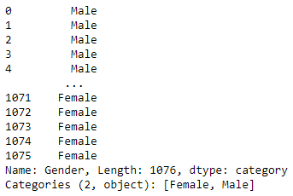
Handling missing values: ffill method
Filling missing values using ffill method of fillna() function
Notes:
The gender has a total of 30 null values.
Using pandas’ fillna function, the missing values for Gender is filled using ffill method.
The ffill method replaces the Null values from the values of previous rows.
In the given figure, we can see the filled values.

Slide 15
Data Exploration
Notes:
Now, that we have cleaned the data lets move on to the Data exploration phase

Slide 16
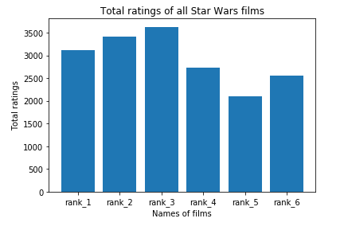
Data Exploration
Notes:
We need to explore the behavior of the data and visualization graphs are the best way to understand the data.
The users were told to rate the 6 films in order of preference with 1 being the favorite film and 6 being the least favorite film.
As there are multiple ratings of users for each film, the sum of those ratings were calculated to find out which film had the highest rating and which film had the least rating. After, calculating the sum of ratings for each film, a bar graph was plotted using plot() function.
The given fig represents the bar graph of the total ratings for each film.
The results include rank_5 (i.e. starwars movie 5) being the highest rated movie and rank_3 (i.e starwars movie 3) with the lowest rating among all.

Slide 17
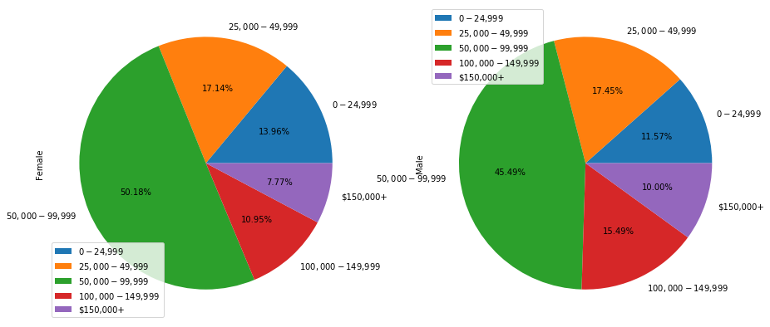
Data Exploration
Notes:
Gender and Household Income were selected to analyze how the population is distributed between Household Income groups.
The Gender and Household Income values of all the users were grouped and the total count for each Household Income value corresponding with the gender value was calculated. Pie chart was used to plot the data using plot function.
In the given fig, we can see that most of the population who have Household Income of 50,000 – 99,999 were Females and the rest were Males. Whereas, there are more Males with an Household Income of 100,000 – 149,999 than Females. Half of the Female population have an Household Income of 50,000 – 99,999 whereas 45.49% of the Males have an Household Income of 100,000 – 149,999 .

Slide 18
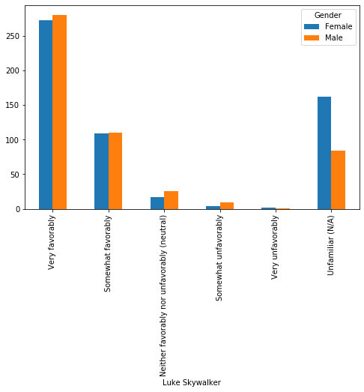
Data Exploration
Notes:
As you’ll can see the different ratings for the Actor, Luke Skywalker, as Very favorably, Somewhat favorably, Neutral, Somewhat unfavorably, very unfavorably and Unfamiliar. The ratings for Luke Skywalker are displayed for both Male and Female population.
Gender and Luke Skywalker columns are grouped and then the different total ratings of Luke Skywalker for both Male and Female are calculated. The plot function is used to display the bar graph.
The given graph illustrates that the Male population having ‘Very favorably’ ratings for Luke Skywalker are more than the female population. Whereas, the Male population having ‘Very unfavorably’ ratings for Luke Skywalker are less compared to Female population. Moreover, both the population have similar no of people who have rated ‘Somewhat unfavorably’ for Luke Skywalker.

Slide 19
Thank You!!
Notes:
This is the end of the data exploration phase.
Thank you all,
we have discussed about data preparation, data exploration and result analysis.

